Slide 1
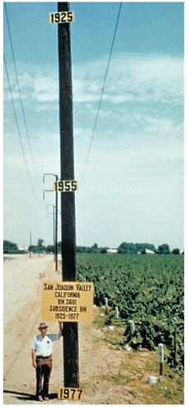
Assignment #3

Slide 2
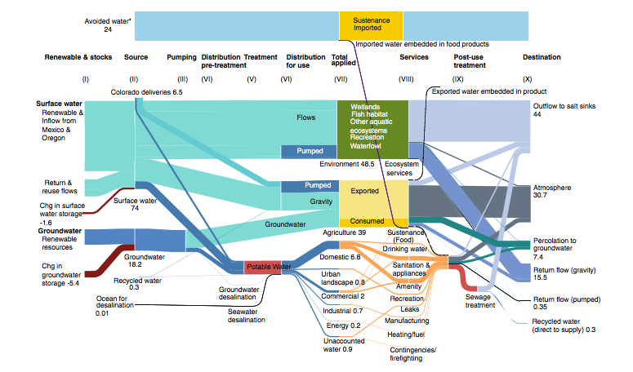

Slide 3
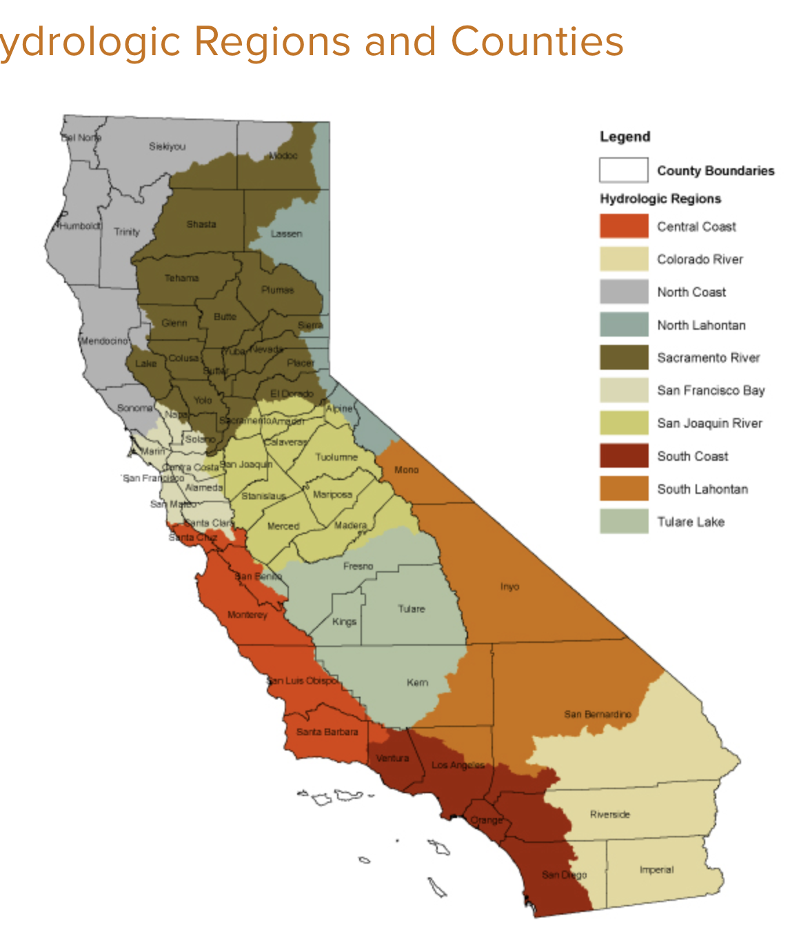
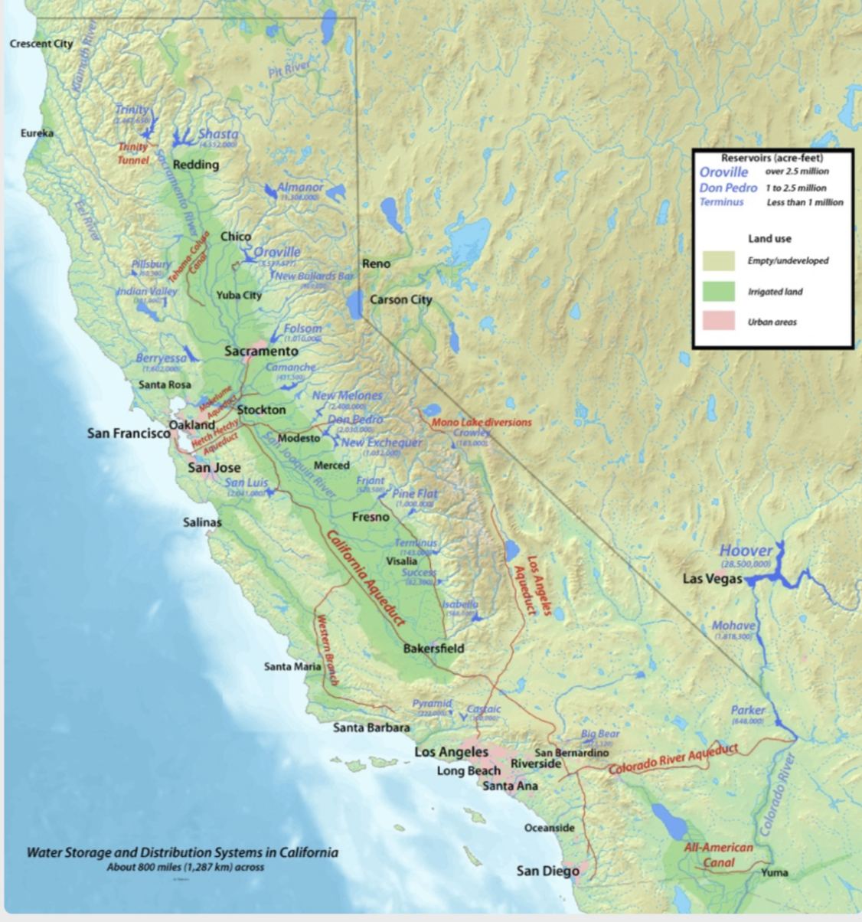
California Hydrologic Regions and Counties
Notes:
California Hydrologic Regions and Counties

Slide 4
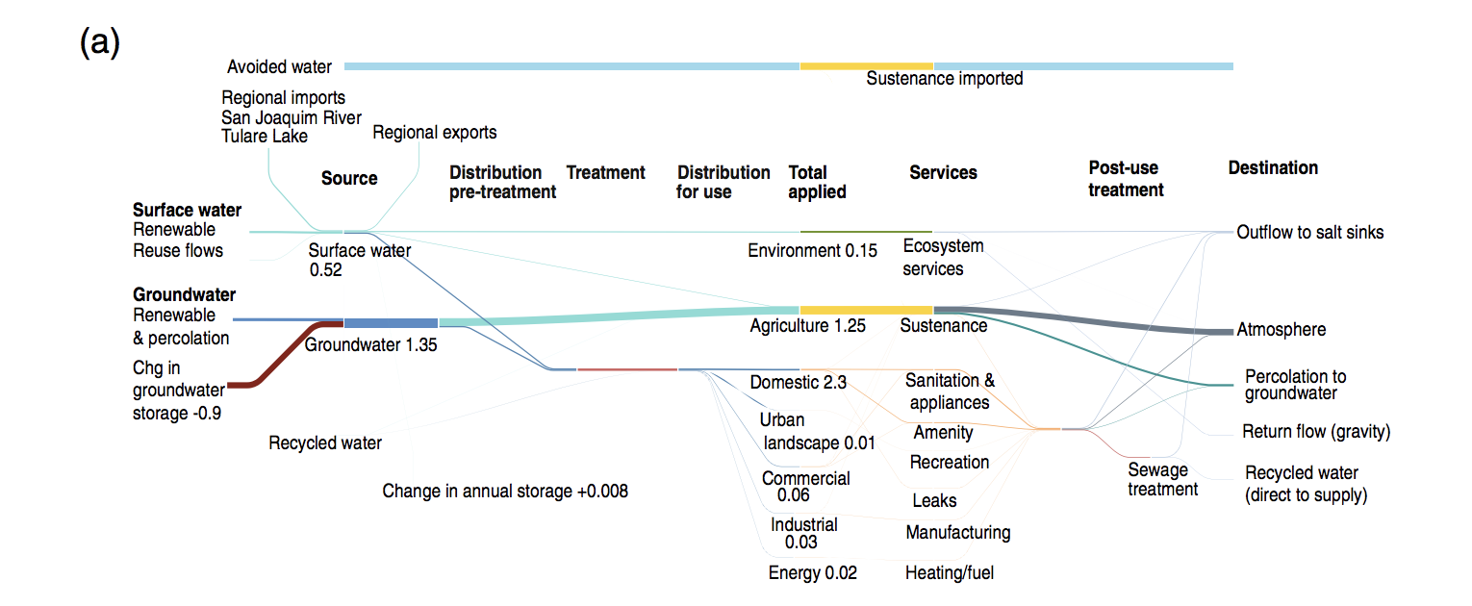
Central Coast Hydrological Region
Notes:
Determine inputs and outputs; how much is in storage

Slide 5
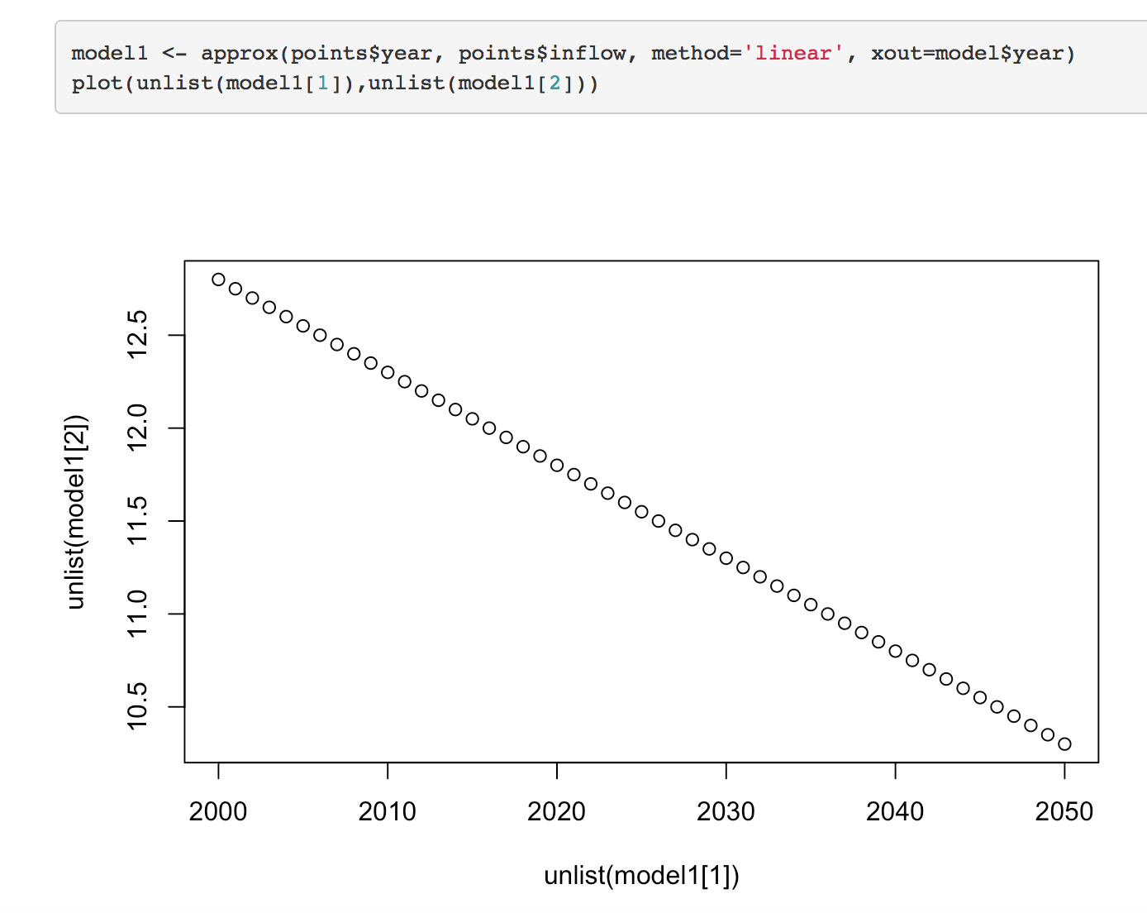
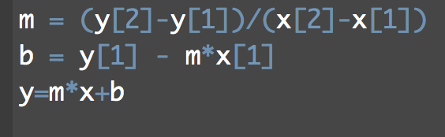
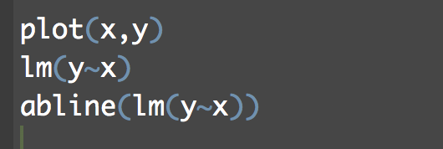
How to fit a linear trend?
Y = mx + b
3. Use a function in R
algebra
2. Linear Model
4. Plot in Excel
Notes:
Why would we need a linear model in the first place ?
How do we account for the amount of water in storage
Is it in steady state?

Slide 6
Different scenarios
BAU
Upper limit
Lower limit
Given an amount in 2000, how do we calculate the next year?
Notes:
Once we know the initial storage, how do we know the next year’s storage?

Slide 7
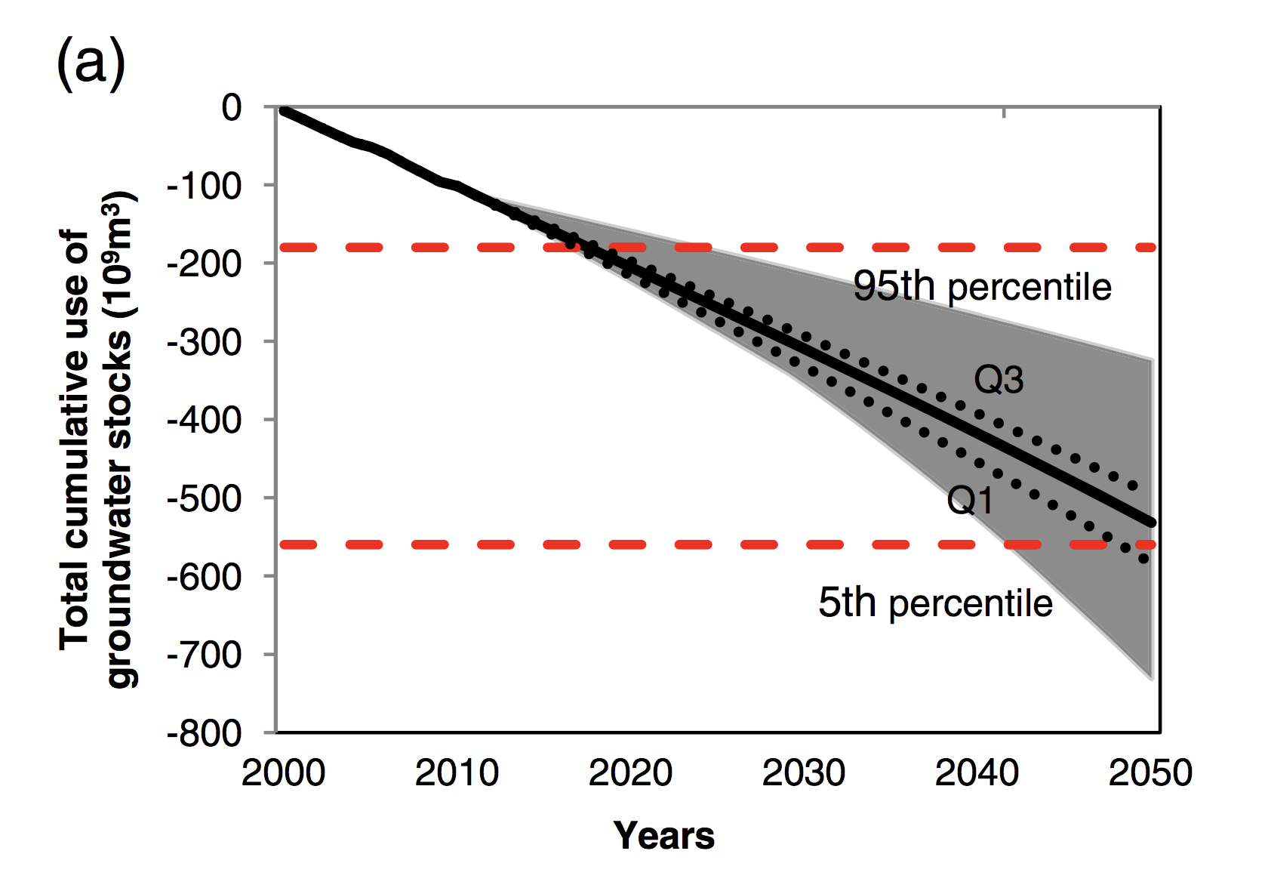
What does this figure tell us about the uncertainty in future groundwater stocks?

